Slide 1
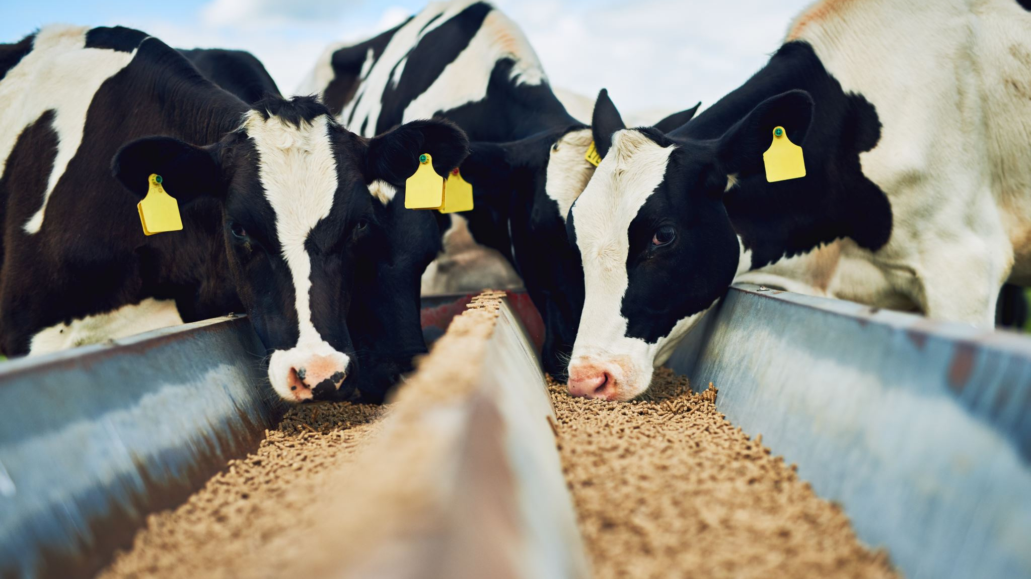
Dairy Farm Management System GUI Module Course Work Presentation
A Project by: K.K.Naveen Rashmika Devinda GADSE251-F-018
Supervised by: Ms.Ashanthi Kurakulasuriya
Notes:
Hello good morning everyone today I came here to present my software i have made for my GUI cw

Slide 2
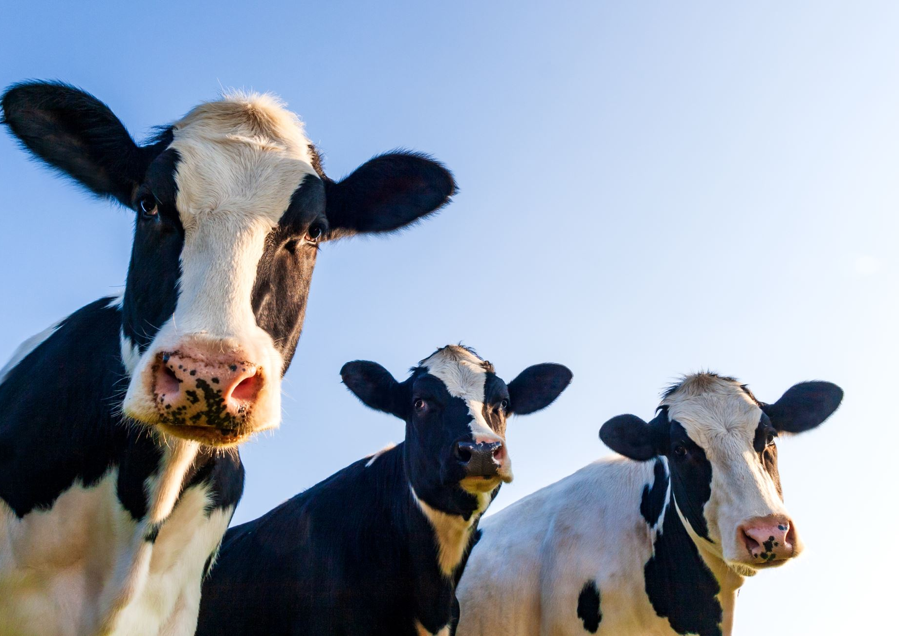
Introduction
There are many medium scale dairy farms in Srilanka.
Their primary business activities are breeding cows,producing milk,storing milk,and making dairy products like yogurts,curd and selling them to local sellers.

Slide 3

Reason for Choosing This Problem to Build a Software
At the moment most of the farms are using manual and paper based records which are difficult to maintain.And even if someone wanted to see a past record it is very time consuming to view them.
So I thought of making a C# winform application computerized system for this problem

Slide 4
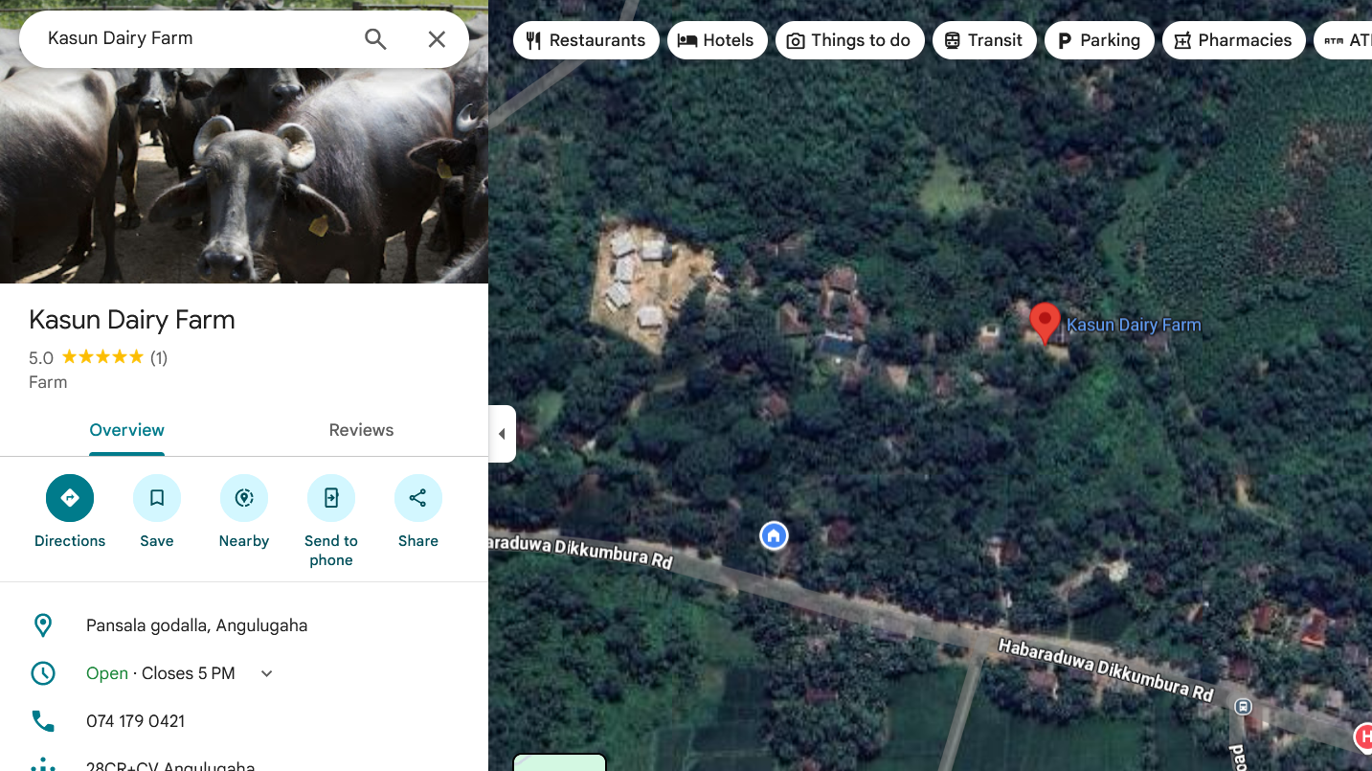
I specifically designed this software for a diary farm near my area
Notes:
And I specifically designed this software for a diary farm near my ares ,and I know the owner of this farm personally aswell so this is the farm Kasun diary farm

Slide 5

Software Requirements Specifications(SRS Doc)
Functional Requirements
System has two use roles,
Admin
Employee
1. Admin Requirements
Admin shall be able to,
Login to the system
Add, update, and delete employee details
View the employee dashboard
Logout from the system
Notes:
Anyway these are my requirements
System has 2 roles..

Slide 6
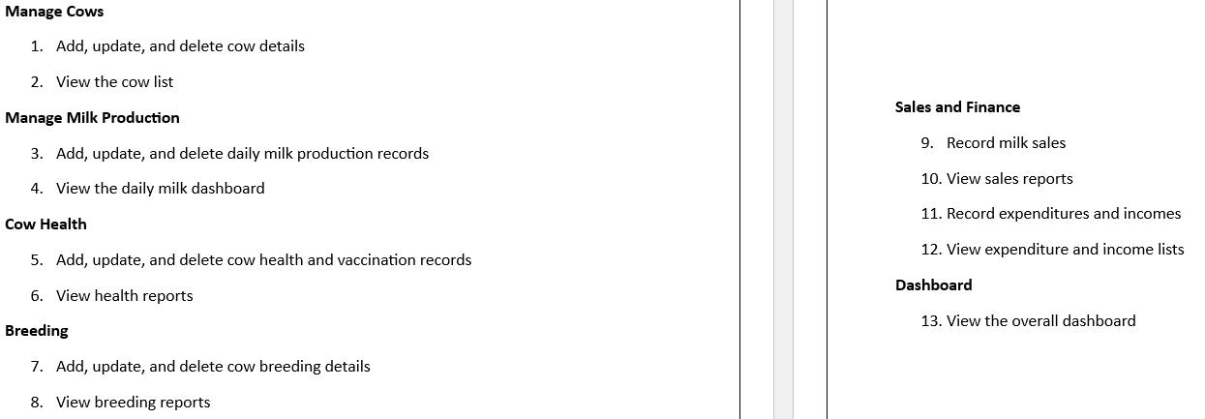

2. Employee Requirements Employee shall be able to,
Notes:
And for employee requirements…

Slide 7

Non-Functional Requirements
System GUI should use a user friendly comfortable theme
All operations should be fast and respond within 2-3 seconds
Security should be high
Validations should be use for necessary places
System reliability should be high
System should be compatible for windows pcs
System should be simple so users can use it easily
Notes:
And for non functional requirements …..
As you will see I ve use a blue and white theme for my whole software and even for this presentation
Validation ,and yeah I ve used them perfectly.

Slide 8
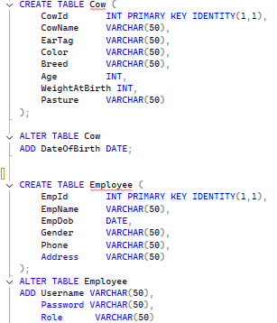
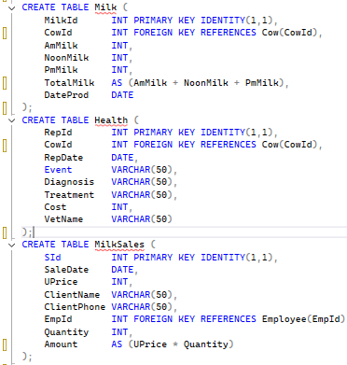
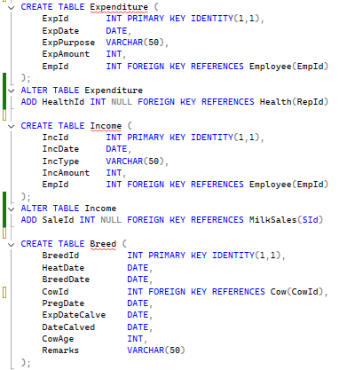
Dairy Farm Database
Notes:
And next these are my databse tables
I have 8 tables

Slide 9
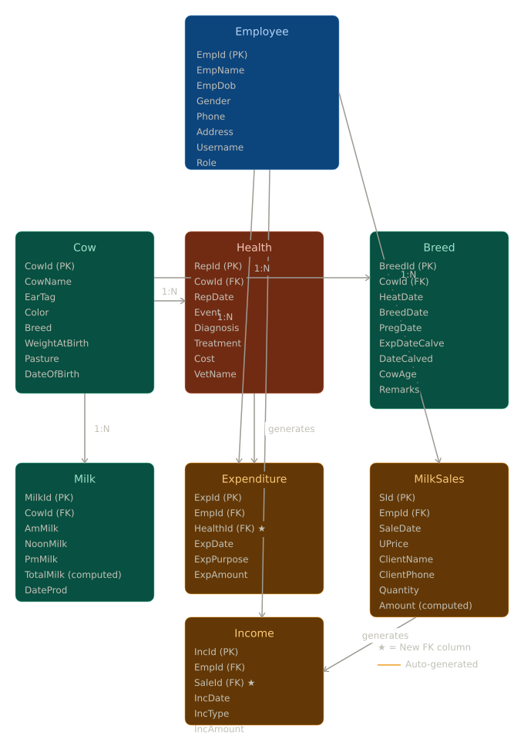
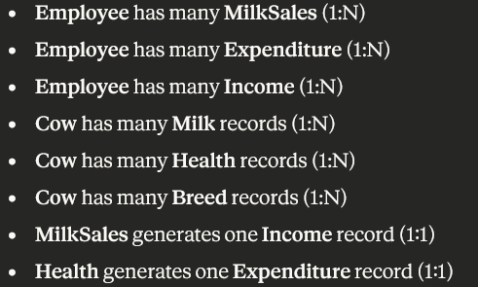
ER Diagram

Slide 10
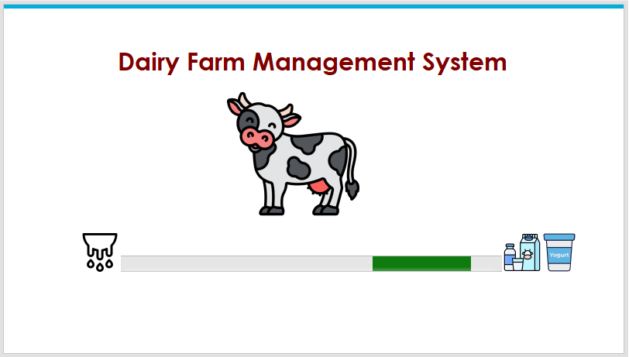
System Forms and Their Functions
Form 1-Loading Screen
This is the first form that user can see when they start the application.
Notes:
So next, these are my system forms and their functions
First I have a loading screen
This is the screen that user can see when they start the program.it takes about 3-4 second to load in to the app

Slide 11
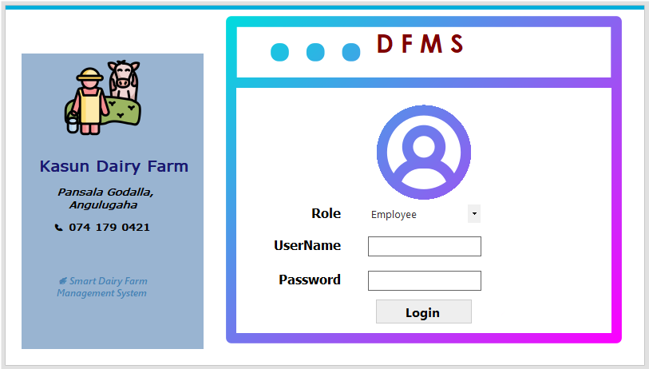
System Forms and Their Functions
Form 2-Login Screen
user logs in, redirects to AdminMenu or EmployeeMenu based on role
Notes:
And This is the 2nd form .in this form use can log in to the system based on their role
and I even showed some details about kasuns farm.like address and telephone number

Slide 12
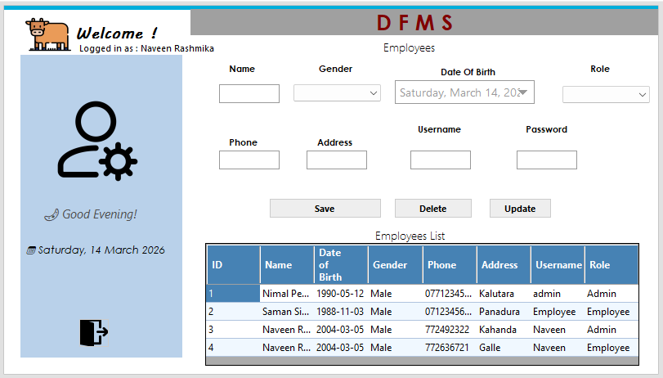
System Forms and Their Functions
Form 3-Admin Menu
admin manages employees (add, update, delete)
Notes:
and
I even make a greeting msg, according to the time it will greet to the user saying good morning ,good evening and good night
User can even see todays date

Slide 13
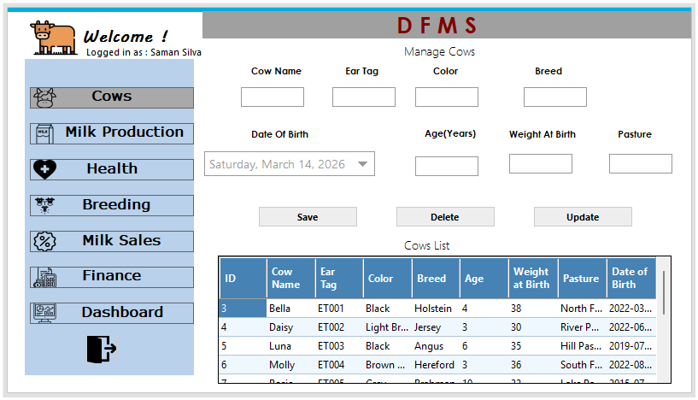
System Forms and Their Functions
Form 4-Employee side Cows
manage cow records (add, update, delete).

Slide 14
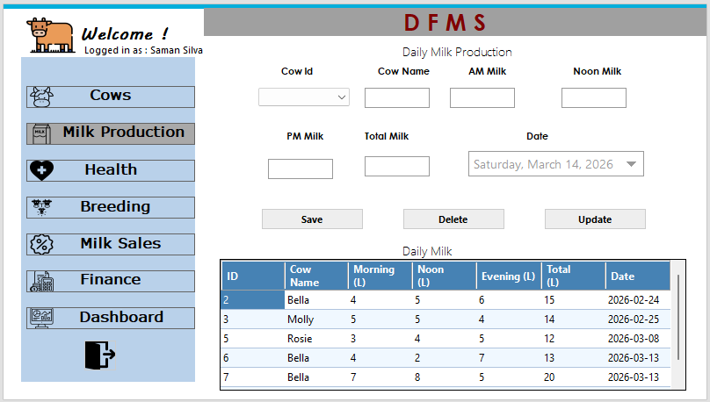
System Forms and Their Functions
Form 5-Milk Production
record daily milk (AM, Noon, PM) per cow
Notes:
In here also total milk is automatically calculated and filled by the system

Slide 15
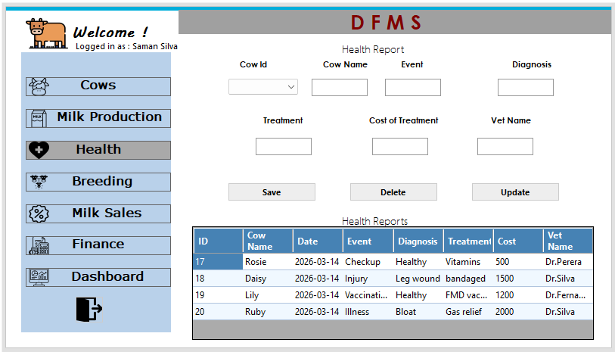
System Forms and Their Functions
Form 6-Health
record helath reports, sys auto adds cost to Expenditure

Slide 16
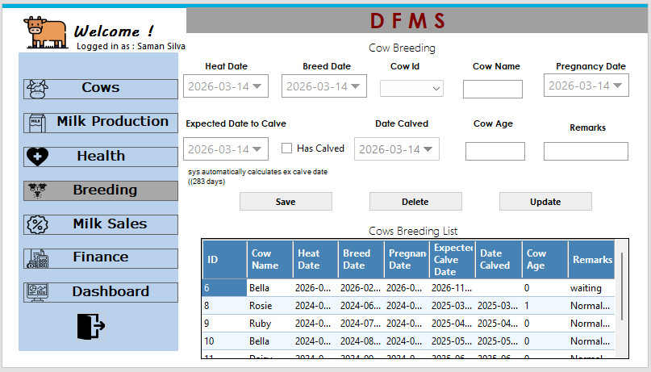
System Forms and Their Functions
Form 7-Breeding
track heat, breed, pregnancy and calving dates
Notes:
kooving
koov
Specialty about this form is
Sys automatically calculates expected calve date form breeding date

Slide 17
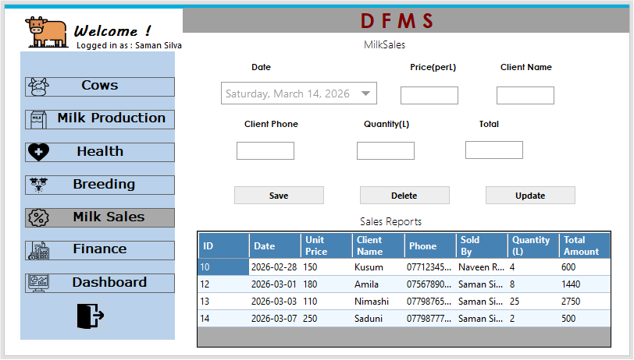
System Forms and Their Functions
Form 8-Milk Sales
record milk sales, and sys auto adds amount to Income
Notes:
Even in this form when employee types price and quantity it automatically fills the total.

Slide 18
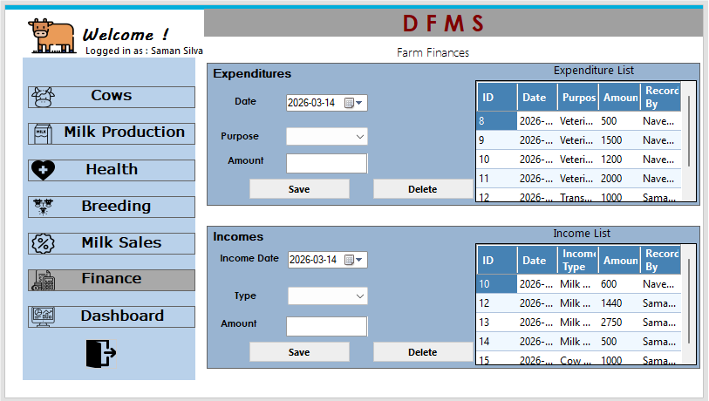
System Forms and Their Functions
Form 9-Finance
record other incomes and expenditures manually

Slide 19
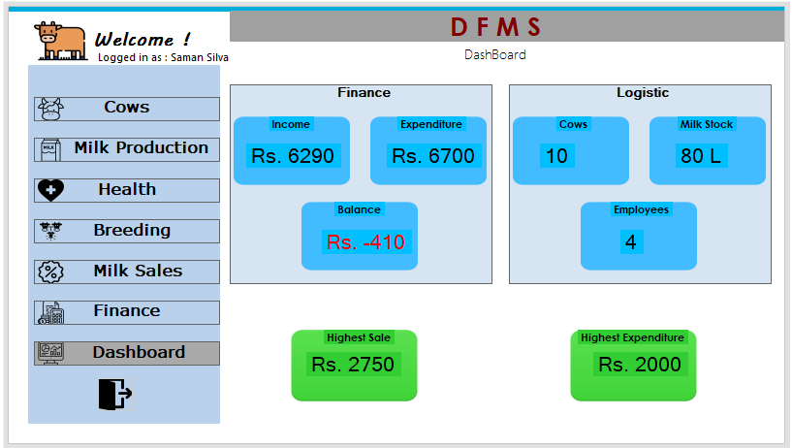
System Forms and Their Functions
Form 10-Dashboard
shows the summary
Notes:
And in this form employee can see the overall summary

Slide 20
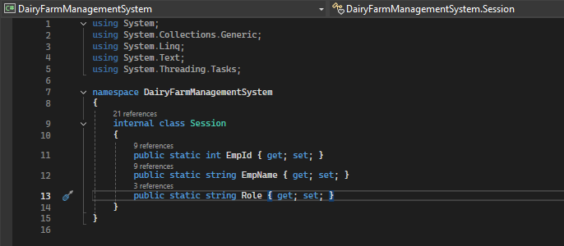
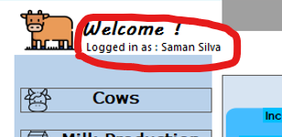
Special classes I used for my project
Session Class
Stores the logged in Users's info (ID, name, role) so all forms know who is currently using the system
Notes:
As you can see in this pic
Its shows users name

Slide 21
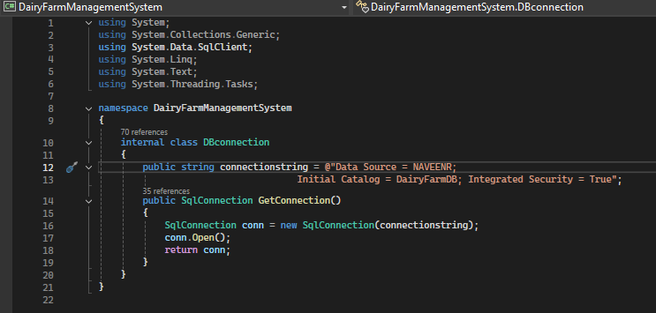
Special classes I used in my project
DBconnection Class
Opens a connection to My SQL Server database so all forms can talk with the database.

Slide 22
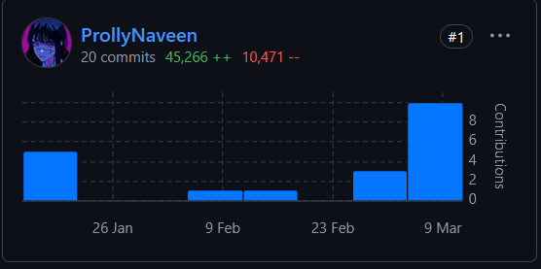
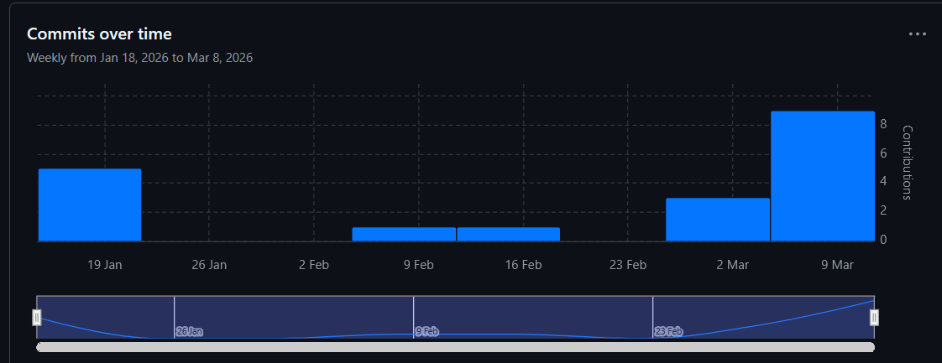
My Github Commits Report
Notes:
And this is my github commit report
As you can see I have started this project on January 19th and finished it on 9th march
And I did 20 commits

Slide 23
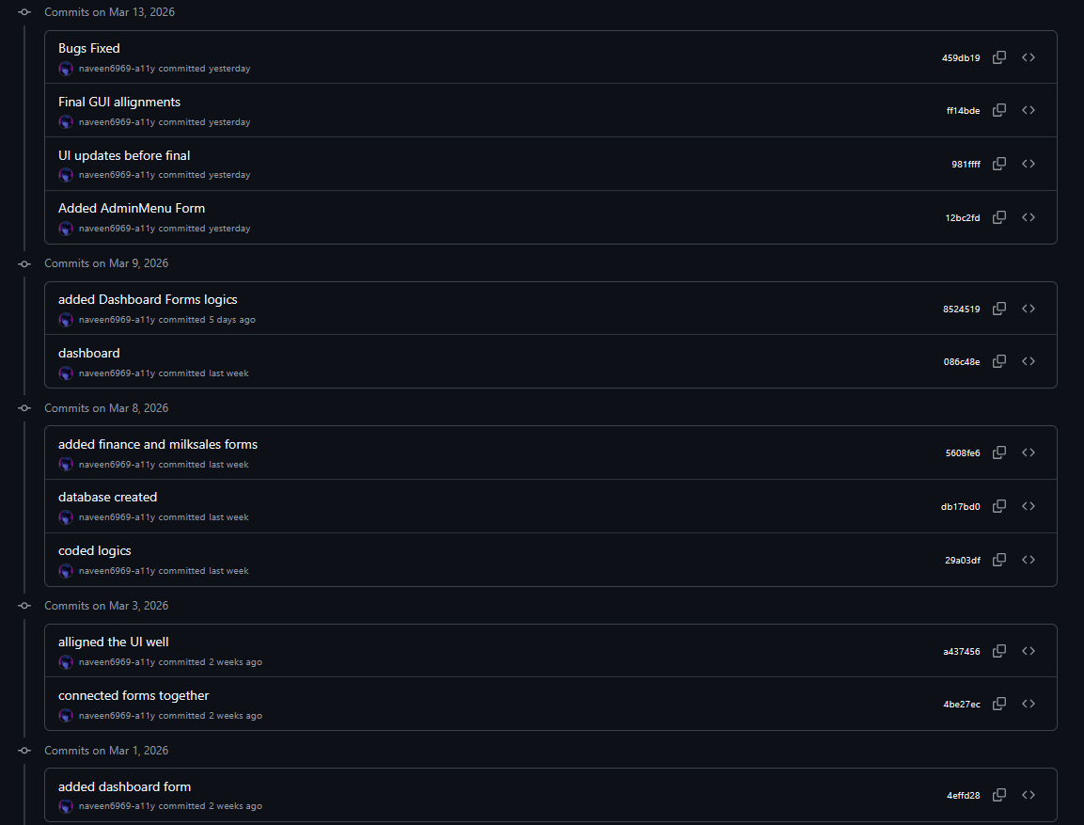
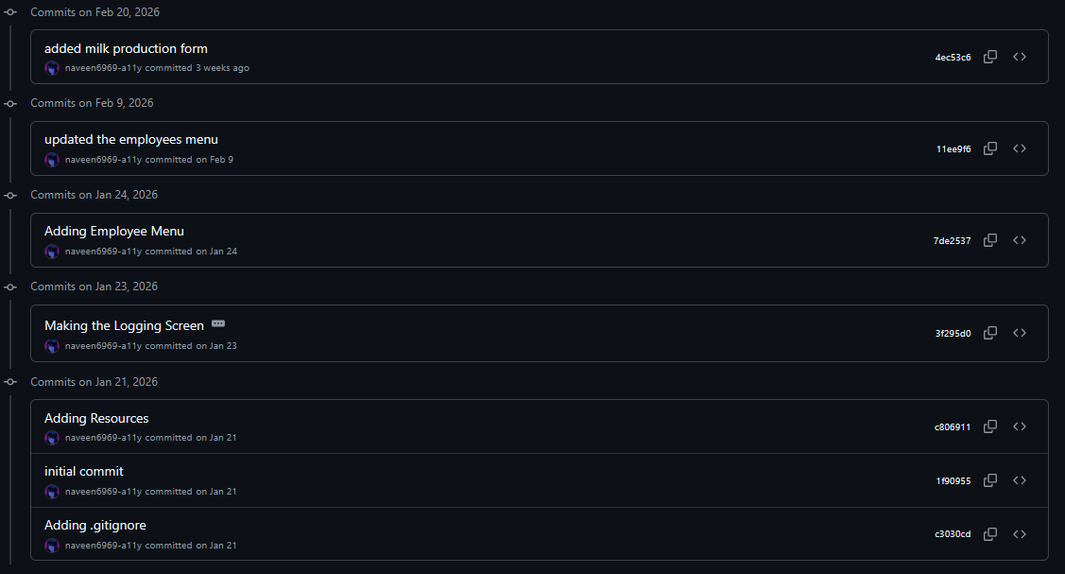
My Commits
Notes:
And these are all the changes I have done to the softwares from the begining

Slide 24
ANY QUESTIONS?
?
Notes:
So ANY QUESTions

Slide 25
Thank you
:)
Feel free to download and use my software for your dairy farm:
https://github.com/ProllyNaveen/DairyFarmManagementSystem
Notes:
And then thank you for your valuable time
Yes you can download my software from that link

